Slide 1
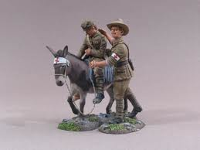
SIMPSON’S DONKEY

Slide 2
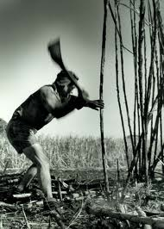
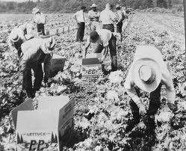
John Simpson Kirkpatrick was born in England. He joined the merchant navy to see the world. When his ship reached Australia, he ran away from the navy in 1910. He loved being in Australia and tried lots of different work.

Slide 3
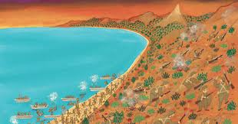
Soon, he joined the AIF (army) thinking that it would be a good way to get back to England to see his Mother and Sister. Instead, he was shipped to Gallipoli to fight in the war. He found himself in a terrible battle that began on 25 April, 1915.

Slide 4
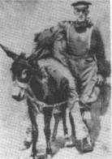
Many Australians and New Zealanders were killed or wounded in that battle. John Simpson found some donkeys at Anzac Cove. He decided to use a donkey to help him to bring the wounded men to safety.

Slide 5
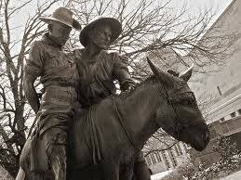
Again and again he went out with the donkey and each time returned with a wounded man. Everyone thought that Private John Simpson was very brave. Each time he journeyed out, there were bullets flying in all directions. He could have been hit but he insisted on going back over and over to rescue the wounded.

Slide 6
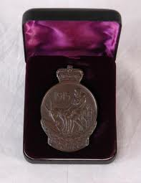
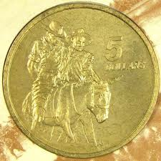
He was very cheerful as he worked, he whistled and sang and told jokes to all around him. John Simpson rescued about 300 wounded men over a few weeks. He was finally killed by a machine gun bullet on 19 May. Many people believe that he should have won a medal for bravery.

