Slide 1
Where Does Mother’s Day come from and when did it start in Australia?

Slide 2
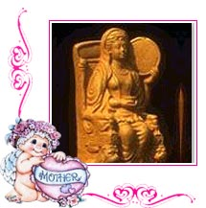
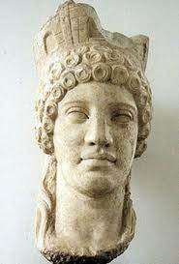
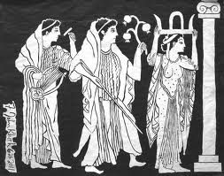
Ancient Greece
Long, long, ago, in ancient Greece, the people paid tribute to Rhea, the Mother of the Gods, each spring.

Slide 3
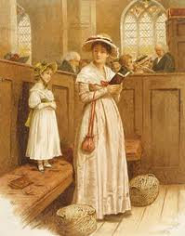
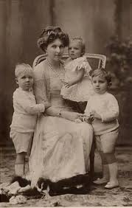
England
A little later in history it is noted that England paid homage to mothers on "Mothering Sunday," the fourth Sunday of Lent. Women and children in service went home to their mothers and to church on this day.

Slide 4
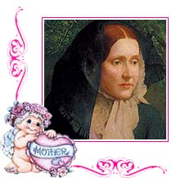
America
In 1872, Julia Ward Howe (who wrote the words to the Battle hymn of the Republic) suggested the idea of Mother's Day. After the work that Mothers did during the war.

Slide 5
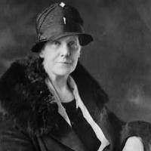
America
Miss Jarvis was very close to her mother Mrs. Anna Reese Jarvis. Anna's mother died in May of 1905, when Anna was 41 years of age. Anna was not married and from the time of her mother's death cared for her blind sister, Ellsinore. Anna missed her mother very much and felt that children should appreciate their mother's more while they're still alive. Anna hoped Mother's Day would increase respect and love and strengthen family bonds.

Slide 6
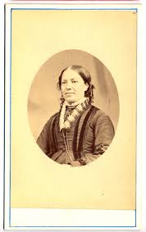
America
In 1907 Anna persuaded her mother's church in Grafton, West Virginia to celebrate Mother's Day on the second anniversary of her mother's death, the 2nd Sunday of May. By the next year, 1908, Mother's Day was also celebrated in Philadelphia.
In 1910 the first Mother's Day proclamation was issued by the governor of West Virginia. Oklahoma celebrated Mother's Day that year also. By 1911 every state observed Mother's Day. The Mother's Day International Association was incorporated on December 12, 1912, with the purpose of furthering meaningful observations of Mother's Day.

Slide 7
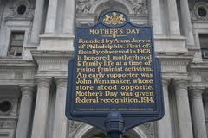
In May, 1913, The House of Representatives unanimously adopted a resolution requesting the President, his Cabinet, members of Congress, and all officials of the federal government to wear a white carnation on Mother's Day. Congress passed another Joint Resolution May 8, 1914, designating the second Sunday in May as Mother's Day.

Slide 8
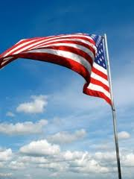
On Mother's Day the U.S. flag is to be displayed on government buildings and at people's homes "as a public expression of our love and reverence for the mothers of our country." President Woodrow Wilson issued the first proclamation making Mother's Day an official national holiday.

Slide 9
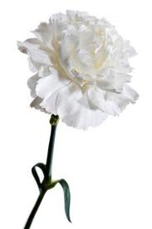
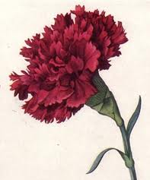
Miss Anna Jarvis's mother's favorite flower was the white carnation. This flower was chosen to represent the sweetness, purity and endurance of mother love.
However, the red carnation has since become the symbol of a living mother while white signifies that one's mother has died.

Slide 10
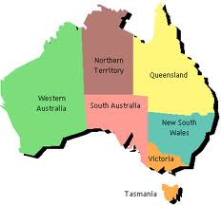
What about Australia?
We follow the tradition of the Americans and celebrate Mother’s Day on the second Sunday in May.
The tradition of gift giving to mothers on Mother's Day in Australia was started by Mrs Janet Heyden, a resident of Leichhardt Sydney, in 1924. She began the tradition during a visit to a patient at the Newington State Home for Women, where she met many lonely and forgotten mothers. To cheer them up, she rounded up support from local school children and businesses to donate and bring gifts to the women.

Slide 11
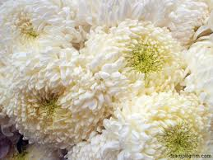
Every year thereafter, more support was raised by Mrs Heyden with local businesses and even the local Mayor. The day has since become commercialised. Traditionally, the chrysanthemum is given to mothers for mother's day as the flower is naturally in season during Autumn and ends in "mum", a common affectionate shortening of "mother" in Australia.

